Slide 1



EYE F R THE BLIND
To create a deep learning model which can explain the content of an image in the form of speech

Slide 3
In this capstone we will cover:
1
Introduction to the capstone
2
Traditional CNN-RNN module
3
Attention model
4
Model training & model evaluation

Slide 5
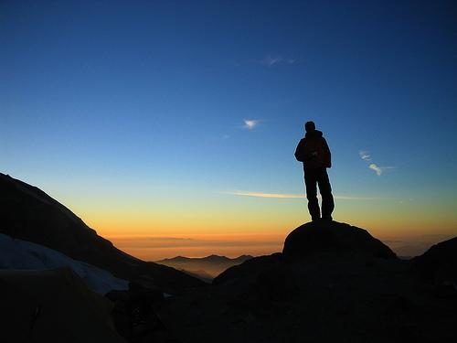


Image to speech
ENCODER
DECODER
TEXT DESCRIPTION
Speech
Image
Problem statement: To create a deep learning model which can explain the content of an image in the form of speech through Caption generation with attention mechanism on Flickr8K dataset. This kind of model is a use-case for blind people so that they can understand any image with the help of speech. The caption generated through a CNN-RNN model will be converted to speech using a text to speech library.
This problem statement is an application of both Deep Learning and Natural Language processing. The features of an image will be extracted by CNN based encoder and this will be decoded by a RNN model

Slide 6
Image to Caption
Image
ENCODER
DECODER
TEXT DESCRIPTION
Ref: Show, Attend & Tell

Slide 7
Encoder
CNN
conv-64
conv-64
max-pool
conv-128
conv-128
max-pool
conv-256
Image
conv-256
DECODER
CAPTION
max-pool
conv-512
conv-512
max-pool
FC-4096
FC-1000
softmax
class
ENCODER

Slide 8
Encoder
CNN
conv-64
conv-64
max-pool
conv-128
Feature vector
conv-128
max-pool
h₀
1*1*1000
conv-256
Image
conv-256
DECODER
CAPTION
max-pool
conv-512
conv-512
max-pool
FC-4096
FC-1000
ENCODER

Slide 9
Decoder
Image
ENCODER
DECODER
CAPTION

Slide 10
Encoder-Decoder
<end>
conv-64
conv-64
max-pool
y₀
y₁
y₂
y_{n}
conv-128
Feature vector
conv-128
max-pool
conv-256
Image
conv-256
h₀
RNN
RNN
RNN
RNN
max-pool
conv-512
conv-512
max-pool
x₀
x₁
x₂
x_{n}
conv-512
conv-512
max-pool
FC-4096
<start>
FC-1000

Slide 12
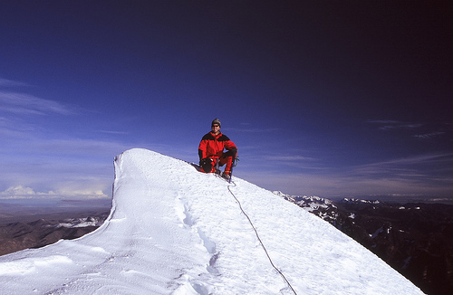
Understanding dataset
Image

Slide 13
Understanding dataset
A man at the top of a mountain with a beautiful view.
A man is sitting on a snowbank.
A man on a snowy peak.
A person in red snow gear is kneeling on a snowy ridge under a blue sky.
A mountain climber in a red suit poses on snowy peak with mountains in the background.
Image
5 Captions/image
Flickr8k dataset – 8091 images

Slide 14
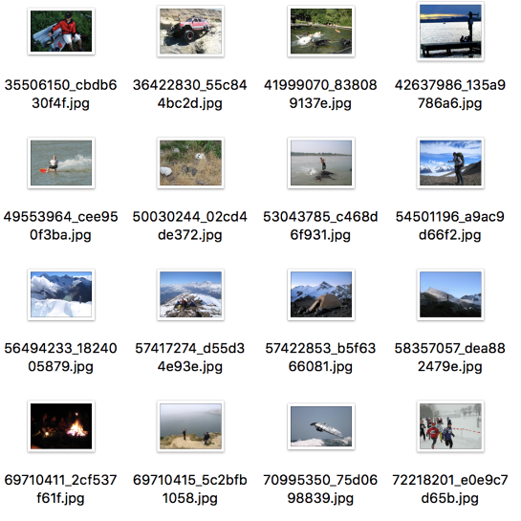
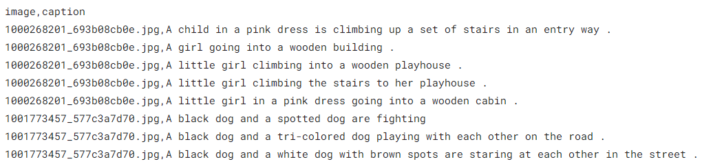
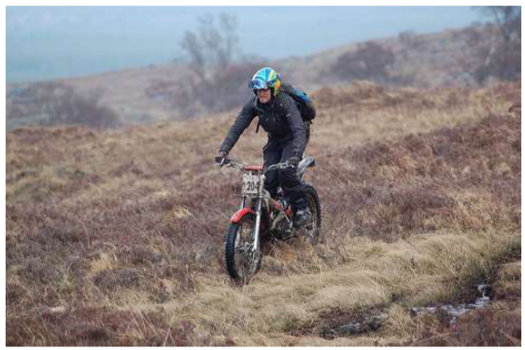
Flicker8k Dataset
Flickr8K dataset contains a variety of images depicting scenes and situations
The dataset consists of 8000 images and each image has 5 corresponding descriptions
captions.txt
A man riding his bike on a hill
A man with helmet and backpack standing on dirt bike in a hilly grassy area
A person rides a motorbike through a grassy field
Man on motorcycle riding in dry field wearing a helmet and backpack
The biker is riding through a grassy plain .

Slide 16
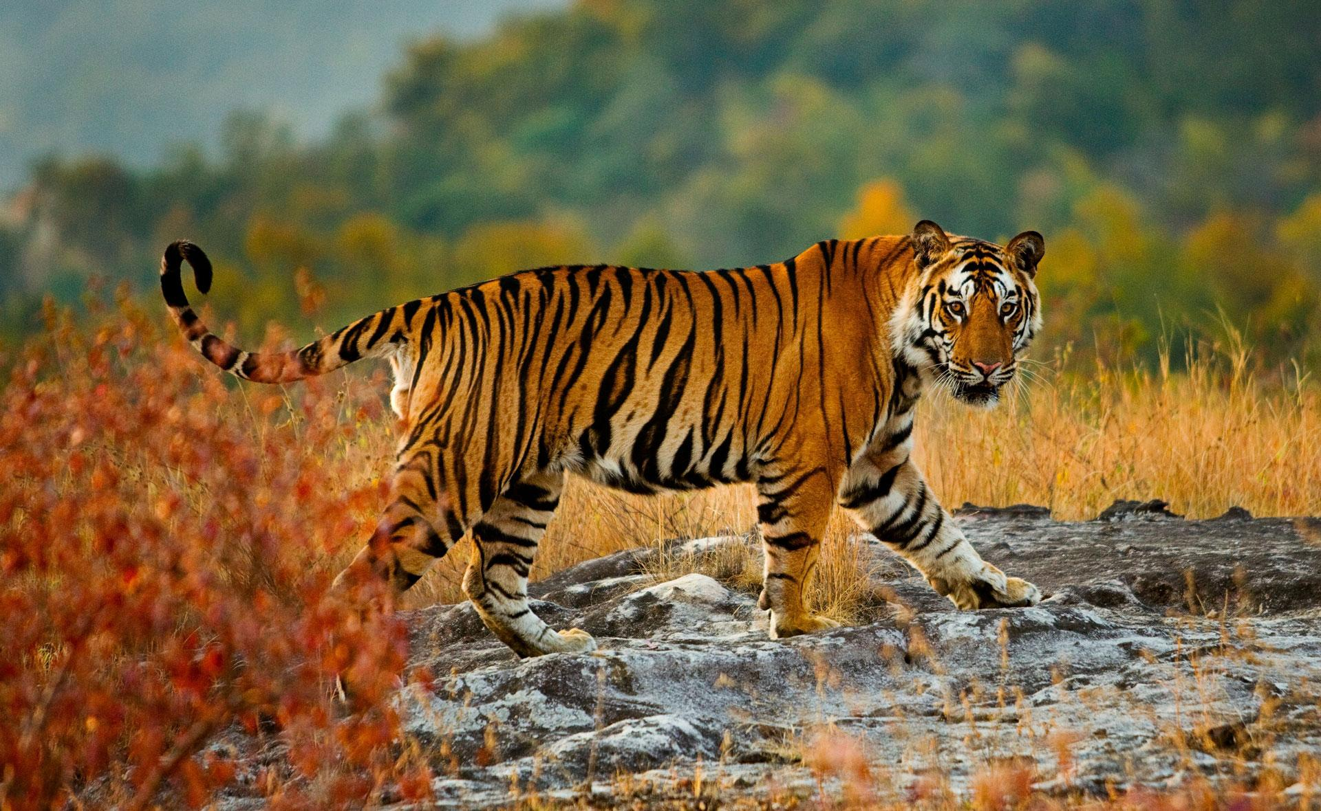
Image to Caption
a
tiger
in
jungle
<end>
CNN
h₀
RNN
Feature vector
ENCODER
DECODER

Slide 17

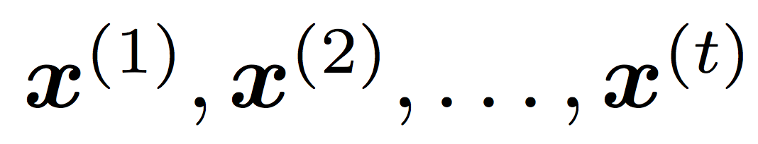
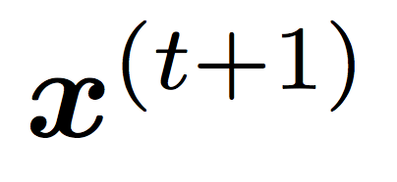
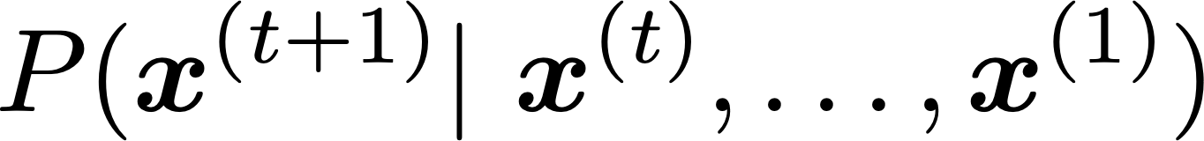
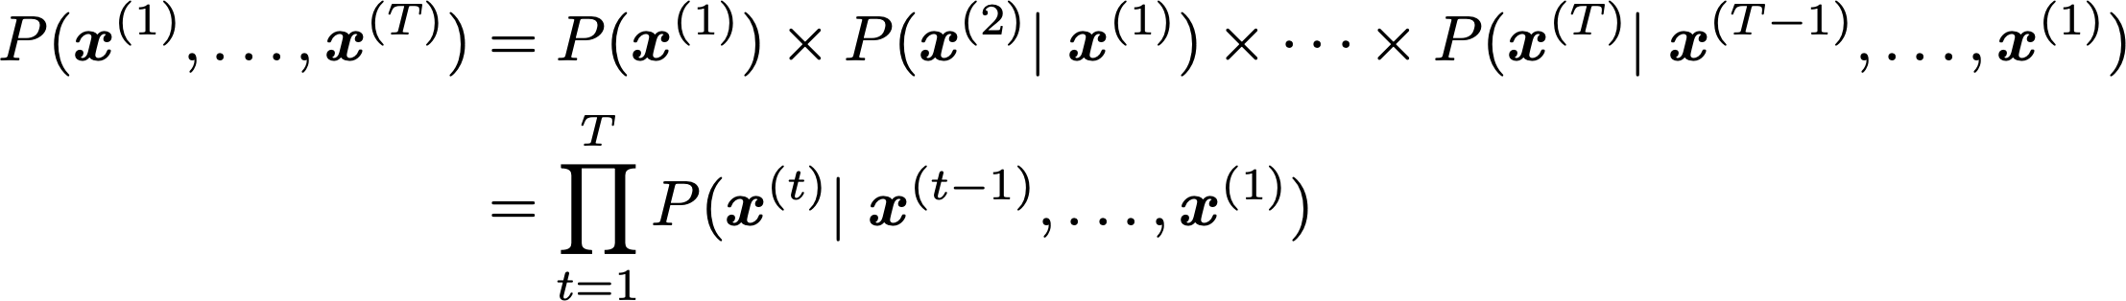
Language model
A Language model is a probability distribution over words in a sentence. It is used to predict the next word in the sentence given the previous word.
The use of neural networks in language modeling is often called Neural Language Modeling (NLM).
More formally: given a sequence of words
compute the probability distribution of the next word
can be any word from our vocabulary
P( the dog is running) = P(the) x P(dog|the) x P(is|the,dog) x P(running|the,dog,is)

Slide 18


Neural Language Model

Slide 19
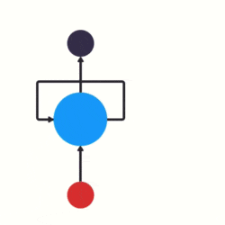
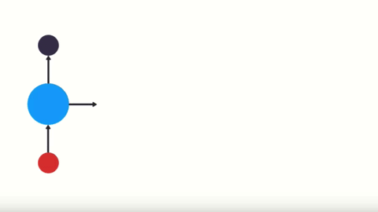
RNN
output
input
RNN
Unrolled form
An RNN has a feedback mechanism which enables it to allow information to flow from one time-step to the next.

Slide 20

RNN
This
<start>

Slide 21
RNN
is
This

Slide 22
RNN
just
is

Slide 23
RNN
amazing
just

Slide 24
RNN
<end>
amazing

Slide 26
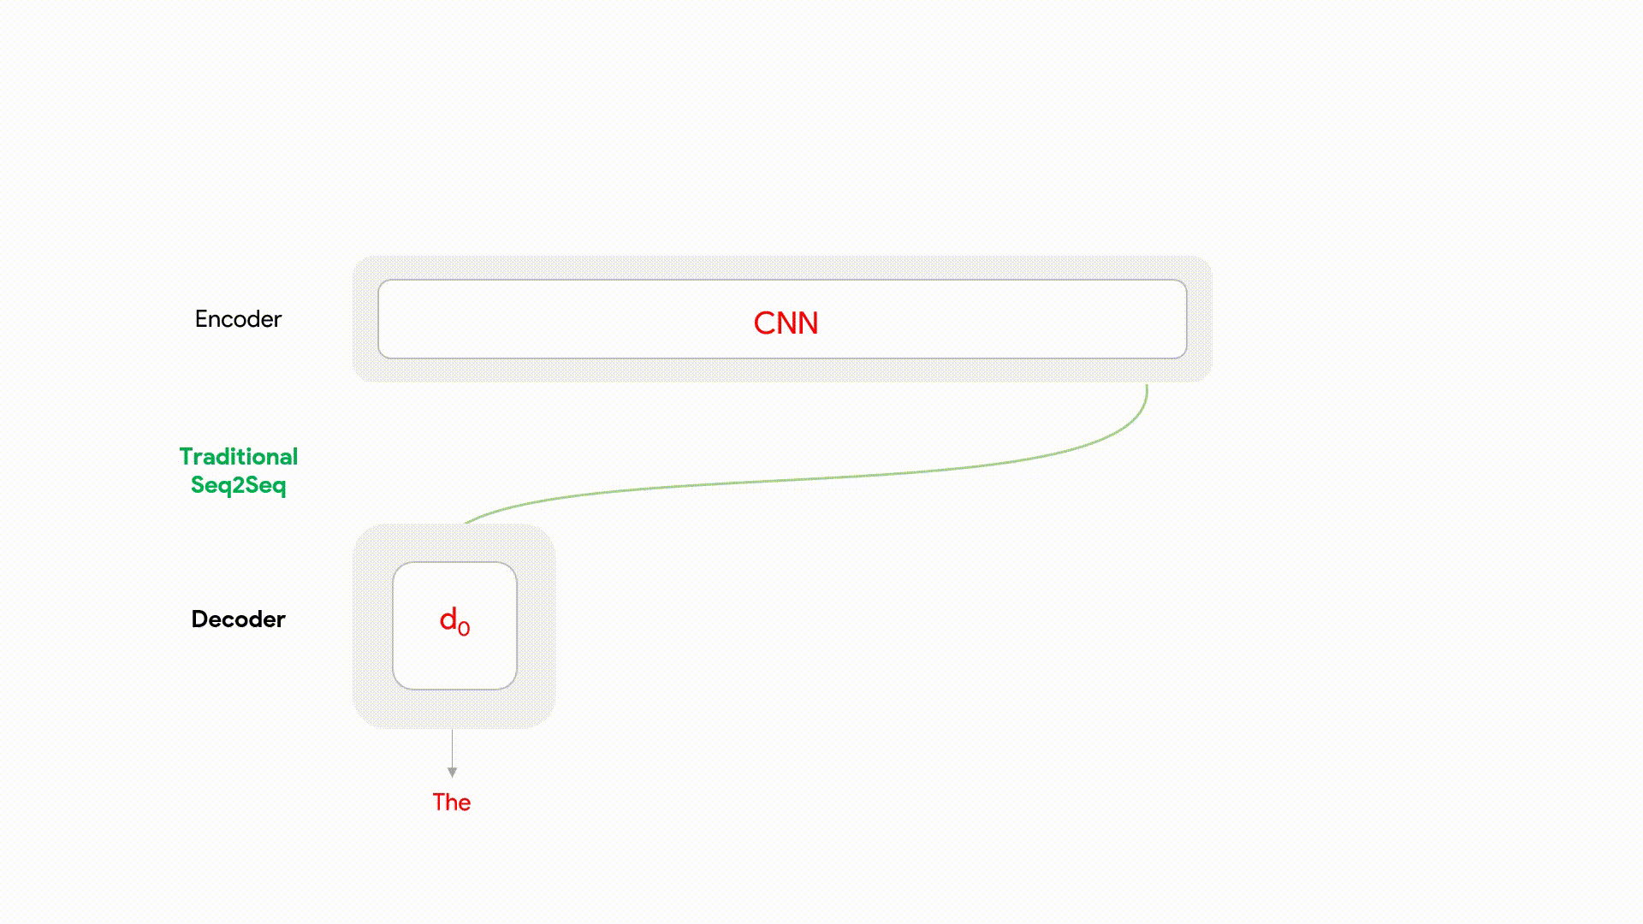
Encoder-Decoder architecture

Slide 27
Encoder-Decoder architecture
Traditional method
prediction
Decoder is trying to predict the next word with just one look at the image(fixed feature vector).
It will not be able to predict accurately the next word just on the entire image, at each time stamp. Because even irrelevant information are passed on which are not important at that time stamp.
RNN
Previous prediction

Slide 28
Encoder-Decoder architecture
Traditional method
prediction
Decoder is trying to predict the next word with just one look at the image(fixed feature vector).
It will not be able to predict accurately the next word just on the entire image, at each time stamp. Because even irrelevant information are passed on which are not important at that time stamp.
RNN
Previous prediction

Slide 29
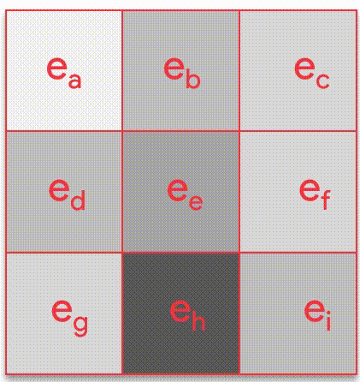
Encoder-Decoder architecture
Modification
prediction
Adaptive feature vector to provide spatial features
The prediction in this case will be more accurate as it will have a context to where to look at depending on the previous prediction at a particular timestamp
This will make the computation faster too.
RNN
Previous prediction

Slide 30
Encoder-Decoder architecture
Modification
prediction
Adaptive feature vector to provide spatial features
The prediction in this case will be more accurate as it will have a context to where to look at depending on the previous prediction at a particular timestamp
This will make the computation faster too.
RNN
Previous prediction

Slide 31
Encoder-Decoder architecture
Modification
prediction
Adaptive feature vector to provide spatial features
The prediction in this case will be more accurate as it will have a context to where to look at depending on the previous prediction at a particular timestamp
This will make the computation faster too.
RNN
Previous prediction

Slide 32
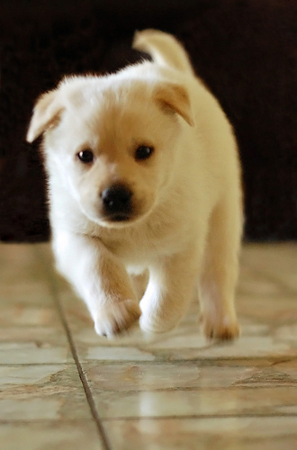
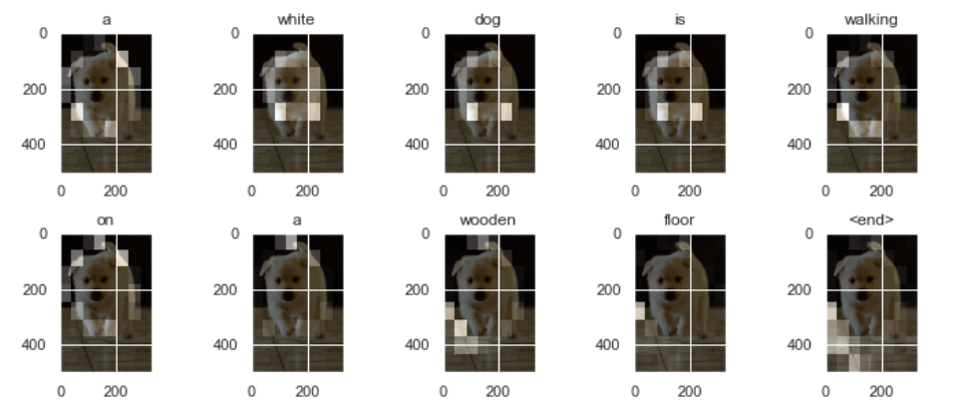
Attention model
a white dog is walking on a wooden floor

Slide 34
Encoder- Decoder architecture
h₀
<start>
Feature vector
Attention model
RNN
The
Attention model
RNN
dog
Attention model
RNN
is
CNN
Attention model
RNN
running
Attention model
RNN
<end>

Slide 35
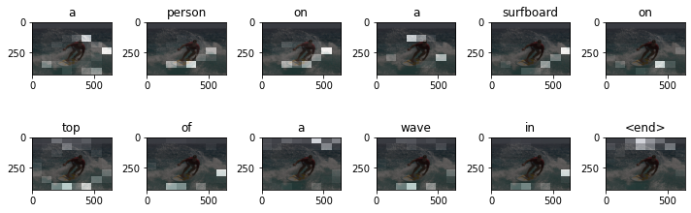
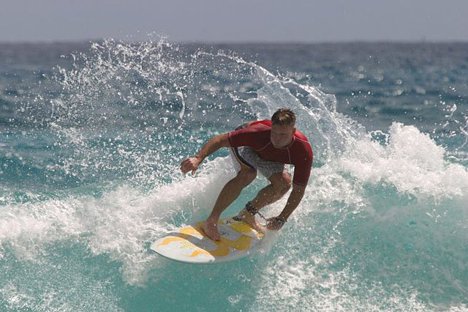
Attention model
<a>
log-likelihood
h₀
Dense
Hidden state from RNN
Context vector
Attention model
RNN
h₁
concat
x₀
Feature vector
Embedding layer
<start>

Slide 36
Attention model
<person>
log-likelihood
h₁
Dense
Hidden state from RNN
Context vector
Attention model
RNN
h₂
concat
x₁
Feature vector
Embedding layer
<a>

Slide 37
Attention model
<on>
log-likelihood
h₂
Dense
Hidden state from RNN
Context vector
Attention model
RNN
h₃
concat
x₂
Feature vector
Embedding layer
<person>

Slide 39
Attention model
e_{jt}= f_{att}(h_{t},f_{j})
How important is the j^{th} area of input image at the t^{th} time stamp
h_{t} 🡪 hidden state of decoder
f_{j} 🡪 state of encoder
f_{att} 🡪 simple feed forward NN

Slide 40
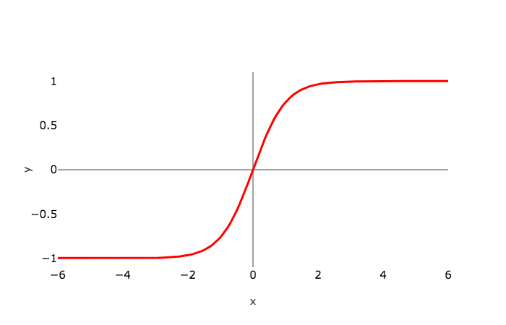
Attention model
e_{jt}= f_{att}(h_{t},f_{j})
e_{a}
e_{b}
e_{c}
f_{att} 🡪 V^{T}_{att} * tanh(U_{att}* h_{t} + W_{att}* f_{j} )
tanh
e_{d}
e_{e}
e_{f}
e_{g}
e_{h}
e_{i}
V^{T}_{att} is introduced to make e_{jt} a scalar value.

Slide 41
Attention model
e_{jt}= f_{att}(h_{t},f_{j})
[0,1]
α_{a}
α_{b}
α_{c}
exp(e_{jt})
_{Tx}
α_{jt} =
Σα_{jt} = 1
_{Tx}
α_{d}
α_{e}
α_{f}
Σ exp(e_{kt})
_{j=1}
_{K=1}
α_{g}
α_{h}
α_{i}
α_{jt} it explains what is the probability of focusing on the j^{th} pixel at the t^{th} time stamp.

Slide 42
Attention model
A
B
C
α_{a}
α_{b}
α_{c}
_{Tx}
Σα_{jt} = 1
D
E
_{F}
*
α_{d}
α_{e}
α_{f}
_{j=1}
G
H
I
α_{g}
α_{h}
α_{i}
_{Tx}
C_{t}= Σα_{jt}f_{j}
Feature
map
Attention weights
_{j=1}
Σ
After doing a weighted sum of all the different regions we get C_{t}
It is the context vector
α_{a}
α_{b}
α_{c}
α_{i}
A
B
C
I

Slide 43
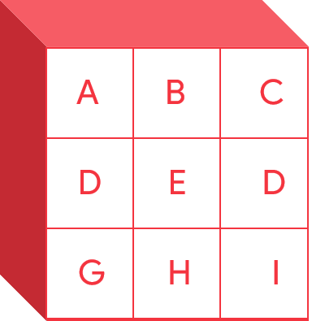
Attention model
Attention model
Pred(t-1)
d₁
h_{t}
Pred_{t}
Pred_{t}, h_{t}= RNN(Pred_{(t-1)},attn(h_{t-1}, f_{encoder}))

Slide 44
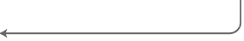
Attention model
W_{decoder}
W_{encoder}
H_{decoder}
W_{decoder} . H_{decoder}
F_{encoder}
W_{encoder} . F_{encoder}
tanh

Slide 45
Attention model
W_{decoder}
W_{encoder}
H_{decoder}
W_{decoder} . H_{decoder}
F_{encoder}
W_{encoder} . F_{encoder}
tanh
Score

Slide 46
W_{decoder}
W_{encoder}
H_{decoder}
W_{decoder} . H_{decoder}
F_{encoder}
W_{encoder} . F_{encoder}
Attention model
tanh
Score
Softmax
Softmax scores
Feature map
multiply
Context vector

Slide 48
Encoder
ENCODER
Image
CNN
((HxW)*C)
((HxW)*C)
(H*W*C)
(64, 2048)
(64, 256)
(H*W)
(8, 8, 2048)
FC
256

Slide 49
Decoder
Images
Encoder
Decoder
(Batch,(HxW)*C)
(32,64, 256)
40 time steps
I/P
I/P
I/P
Seq_length
(Batch,seqlength)
(32,40)
Captions
Pre-processing

Slide 50
Putting it all together
logits
logits
logits
dense
dense
dense
O/P
O/P
O/P
Initial
state
GRU
GRU
GRU
end
state
concat
concat
concat
Attention
model
Attention
model
Attention
model
Images
Encoder
(Batch,(HxW)*C)
Embedding
layer
Embedding
layer
Embedding
layer
(32,64, 256)
I/P
I/P
I/P
Seq_length
(Batch,seqlength)
(32,40)
Captions
Pre-processing

Slide 51
Putting it all together
logits
logits
logits
Batch size, vocab size
(32,5001)
dense
dense
dense
O/P
O/P
O/P
Batch size, 1, units
(32, 1, 512)
Initial
state
GRU
GRU
GRU
end
state
Batch size, units
(32,512)
concat
concat
concat
Batch size, 1, 2*embed size
(32, 1, 512)
Attention
model
Attention
model
Attention
model
Batch size, embed size
(32,256)
Images
Encoder
(Batch,(HxW)*C)
Embedding
layer
Embedding
layer
Embedding
layer
Batch size, 1, embed size
(32,1, 256)
(32,64, 256)
I/P
I/P
I/P
Batch size, 1
(32,1)
Seq_length
(Batch,seqlength)
(32,40)
Captions
Pre-processing

Slide 53
Model training
[ ["Hello", "world", "!"], ["How", "are", "you", "doing", "today"], ["The", "weather", "will", "be", "nice", "tomorrow"], ]

Slide 54
Model training
[ ["Hello", "world", "!"], ["How", "are", "you", "doing", "today"], ["The", "weather", "will", "be", "nice", "tomorrow"], ]
[ [71, 1331, 4231] [73, 8, 3215, 55, 927], [83, 91, 1, 645, 1253, 927], ]
Token ids
[
[ True, True, True, False, False, False],
[ True, True, True, True, True, False],
[ True, True, True, True, True, True]
]
[ [71, 1331, 4231 ,0 ,0 ,0 ] [73, 8, 3215, 55, 927 ,0], [83, 91, 1, 645, 1253, 927], ]
Mask
Padding

Slide 55
Model training
[ ["Hello", "world", "!"], ["How", "are", "you", "doing", "today"], ["The", "weather", "will", "be", "nice", "tomorrow"], ]
[ [71, 1331, 4231] [73, 8, 3215, 55, 927], [83, 91, 1, 645, 1253, 927], ]
Token ids
[
[ 1, 1, 1, 0, 0, 0],
[ 1, 1, 1, 1, 1, 0],
[ 1, 1, 1, 1, 1, 1]
]
[
[ True, True, True, False, False, False],
[ True, True, True, True, True, False],
[ True, True, True, True, True, True]
]
[ [71, 1331, 4231 ,0 ,0 ,0 ] [73, 8, 3215, 55, 927 ,0], [83, 91, 1, 645, 1253, 927], ]
Loss= Loss * Mask
Mask
Mask
Padding

Slide 56
Model training
Attention model
<start>
ENCODER
Decoder
Target [ : , i ]
d₀
Pred 1
Loss
Loss *= Mask

Slide 57
Model training
Attention model
Attention model
<start>
Teacher Forcing
Target [ : , i ]
ENCODER
Decoder
Target [ : , i+1 ]
d₀
d₁
Pred 2
Loss
Loss *= Mask

Slide 58
Model Evaluation
Attention model
<start>
ENCODER
Decoder
d₀
appended
Argmax(pred)
Result

Slide 59
Model Evaluation
Attention model
Attention model
<start>
Previous prediction
Pred(t-1)
ENCODER
Decoder
d₀
d₁
appended
Argmax(pred)
Result

Slide 61

EYE FOR THE BLIND
PIPELINES OF THE CAPSTONE
DATASET CREATION
MODEL BUILDING
MODEL TRAINING
MODEL EVALUATION

Slide 62
EYE FOR THE BLIND
PIPELINES OF THE CAPSTONE
FEATURE EXTRACTION
DATASET CREATION
MODEL BUILDING
DATASET CREATION
MODEL TRAINING
DATA PROCESSING
MODEL EVALUATION
DATA UNDERSTANDING

Slide 63
EYE FOR THE BLIND
PIPELINES OF THE CAPSTONE
DECODER
DATASET CREATION
MODEL BUILDING
ATTENTION NETWORK
MODEL TRAINING
MODEL EVALUATION
ENCODER

Slide 64
EYE FOR THE BLIND
PIPELINES OF THE CAPSTONE
TRAIN & TEST STEPS
DATASET CREATION
MODEL BUILDING
CHECKPOINT CREATION
MODEL TRAINING
MODEL EVALUATION
OPTIMISER & LOSS SETTING

Slide 65
EYE FOR THE BLIND
PIPELINES OF THE CAPSTONE
TESTING ON BLEU SCORE
DATASET CREATION
MODEL BUILDING
BEAM SEARCH(OPTIONAL)
MODEL TRAINING
MODEL EVALUATION
GREEDY SEARCH

